Slide 1
Dmi-st.eugene-university chibombo campus final year project presentation
NAME: MUNALULA SIKAZWE
STUDENT NUMBER: 17221351006
PROJECT TITLE: CYBERSECURITY MINI-TOOLKIT
PROJECT ADVISER: VERNON SIVUBWA

Slide 2
PROJECT ABSTRACT
The Cyber Security Mini-ToolKit will aim to push the knowledge of the CyberSecurity World to the ordinary citizen.The toolkit is built with an offline design in mind with the tkinter visual programming desktop interface The project is a unique innovation aimed at combining all useful demonstrations in the world of cyber security .The Include data-integrity with the checksum verifier , confidentiality with the steganographic encrypter and Authentication with the secure password Generator .The motivation of this project is based on enivronments lacking access to a decent internet connection .

Slide 3
Problem statement
Files can be altered and modified which violates integrity
The ability to verify file integrity
Malicious code can be embedded within files and files may be modified to facilitate fraudulent behavior
Creating a verification mechanism for the verification of file integrity
Secure passwords are necessary to ensure security in the modern age
The most secure password is one that is random and is of a sufficiently long length
Secrecy is necessary for the transition of information

Slide 4
Literary survey
Cherubini, Mauro & Meylan, Alexandre & Chapuis, Bertil & Humbert, Mathias & Bilogrevic, Igor & Huguenin, Kévin. (2018). Towards Usable Checksums. Most Internet users in the US rely on the latter, according to our representative study, which makes them directly responsible for the content they download. To enable users to detect if the downloaded files have been corrupted, developers can publish a checksum together with the link to the program file; users can then manually verify that the checksum matches the one they obtain from the downloaded file. In this paper, we assess the prevalence of such behavior among the general Internet population in the US (N=2,000), and we develop easy-to-use tools for users and developers to automate both the process of checksum verification and generation. Specifically, we propose an extension to the recent W3C specification for sub-resource integrity in order to provide integrity protection for download links. Also, we develop an extension for the popular Chrome browser that computes and verifies checksums of downloaded files automatically, and an extension for the WordPress that developers can use to easily attach checksums to their remote content. Our in situ experiments with 40participants demonstrate the usability and effectiveness issues of checksums verification, and shows user desirability for our extension.

Slide 5
Existing system
The current system is not user friendly as it is a commandline tool
An example of this is the Microsoft commandline verifier
The existing system that is automated is embedded in the browser and cannot be used to verify files that are downloaded or transferred using different sources
The current system does not combine the four elements of the toolkit
The CyberSecurity field hugely relies on the proprietary standalone systems created by the individual and contracted companies

Slide 6
PROPOSED SYSTEM
The proposed system is an offline system that can calculate realtime hashes
It should be graphical unlike the Existing System
It should be able to compute hashes for any file
It should be platform independent
The proposed system will implement the three cybersecurity artifacts

Slide 7
SYSTEM OBJECTIVES
To compute Hashes and compare them in real-time
To create and ensure data integrity
To create a simple , usable and portable platform for ensuring data integrity of any file
Platform Independent
Requires a graphical output e.g Monitor

Slide 8
SYSTEM SPECIFICATIONS
The system should possess at least 2gb of ram
The system should possess at least 1gb harddisk space
Python must be installed
Minimum 126mb of graphics memory
Minimum 2GHz processor speed (preferably intel)

Slide 9
System architecture
Cyber Security Mini tool-kit
CheckSum
Verifier
Password Generator
Steganography tool

Slide 10
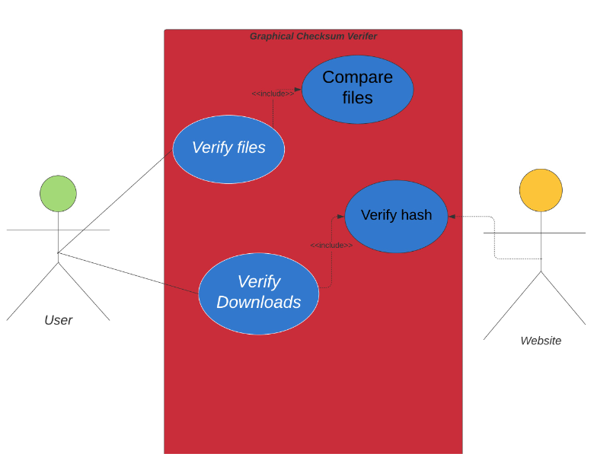
Use case diagram

Slide 11
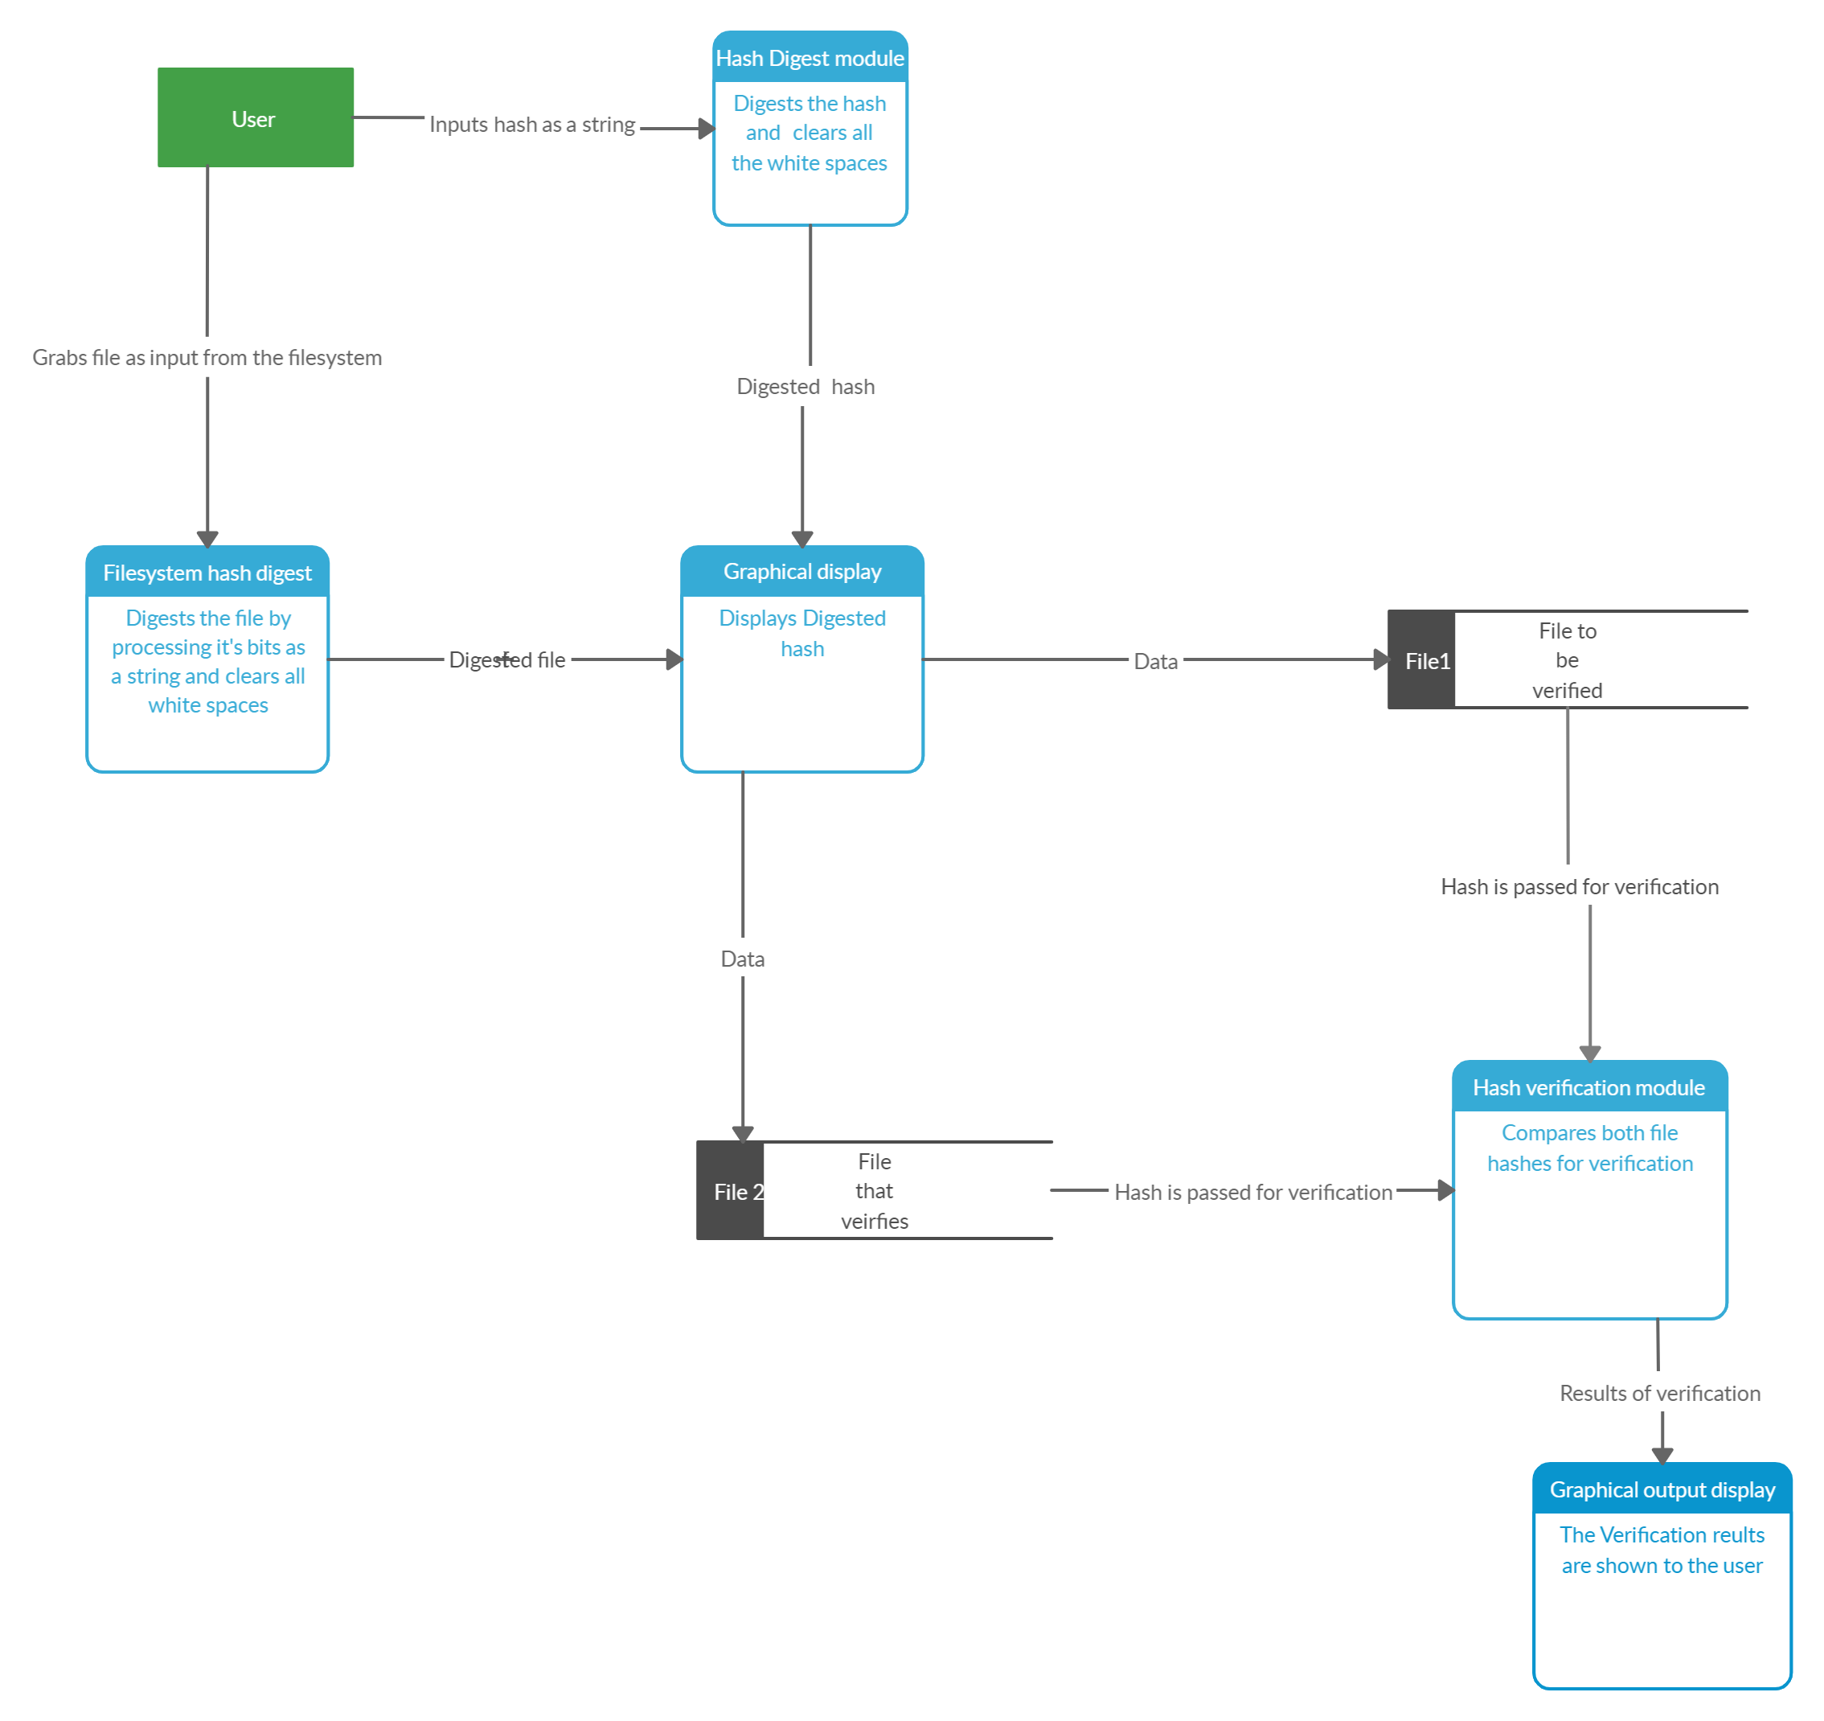
Dfd diagram

Slide 12
Table design
Conditions | Tampered file | Tampered file | Tampered file | Verified
Test file hash | F | T | F | T
Original | F | F | T | T
Output | F | F | F | T

Slide 13
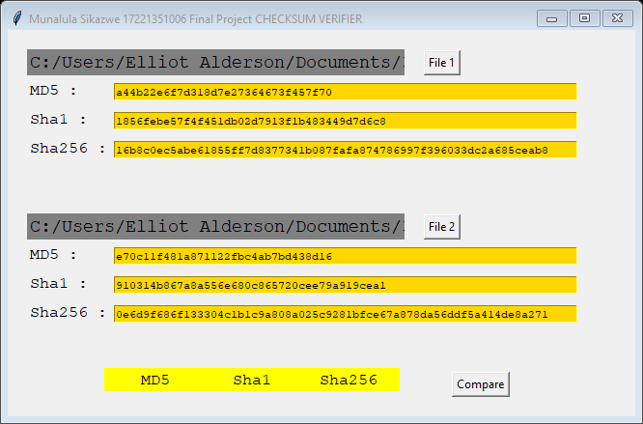
Input design
Hashes can be inputted as strings directly

Slide 14
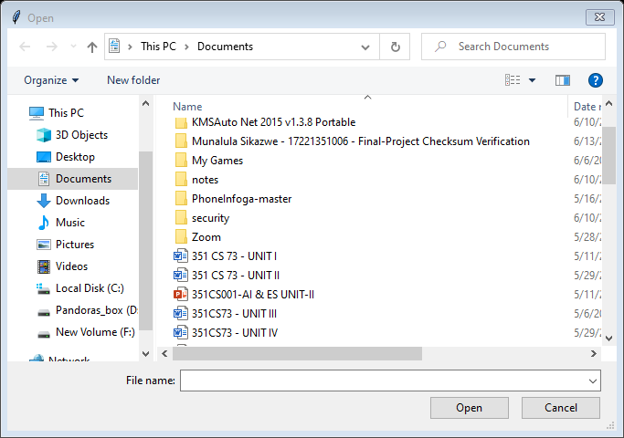
Input design
Files can be inputed from the file system

Slide 15
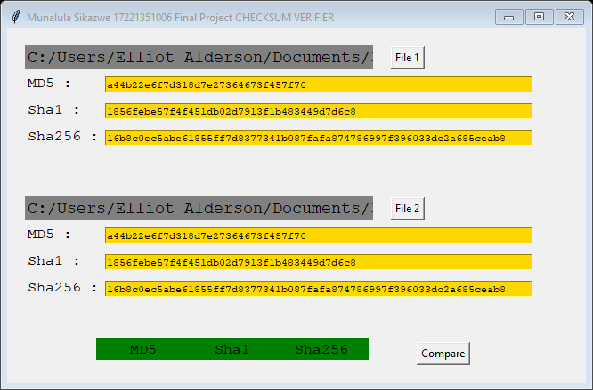
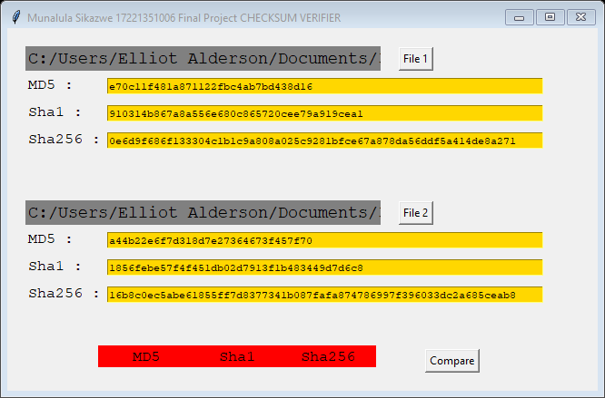
Output design
Output forms of the data
Verification Successful File Tampered
COLOR CODED
VERIFICATION

Slide 16
Project Description
The Cyber Security tool-kit will aim to allow give firm file integrity by ensuring the uniqueness of every file by ensuring a thorough computation of files of many formats and ensuring that these files can be verified any point at which a user chooses with accuracy , formal and secure mathematical algorithims such as the sha hashing algorithm.
The toolkit will allow any user to have a practical feel of the concepts of steganography and encryption .

Slide 17
Conclusions
This system will enhance data integrity for files in a way that will allow even the layman to have a simple but hands on method of dealing with data integrity risks and their mitigation.
A possible integration with File transfer systems

